Slide 1
Communication Strategies and Tools for Championing Whole Health
Note: You will need a note-taking medium (digital or analog)
Mikhail “Misha” Kogan, MD, ABIOM, RCST
Leigh A. Frame, PhD, MHS

Slide 2



Breaking into Social Media:
Best Practices & Lessons Learned
@PhD_Leigh
#GWSMHS
Leigh A. Frame, PhD, MHS
Chief Wellness Officer, Medicine
Director, Resiliency & Well-being Center
Executive Director, Office of Integrative Medicine & Health
Associate Professor, Clinical Research & Leadership / Physician Assistant Studies

Slide 3
Potential Conflicts of Interest
Affiliation/Financial Interests | Prior 24 Months
Grants/Research Support | BUCK Cancer Foundation TMCity Foundation
Scientific Advisory Board/ Consultant/Board of Directors | Consultant, Access Integrative Medicine (AIM) Health Institute Scientific Advisory Board, Evimero (formerly Scaled Microbiomics), Scientific Advisory Board, Covimro Ltd Board of Trustees, Mary Baldwin University Scientific Advisory Board, ASYSTEM Inc Scientific Advisory Board, TerraCycle Discovery Scientific Advisory Board, Other Culture Scientific Advisory Board, People Brand Co. Consultant, Haleon
Speakers Bureau/Honoraria | The American Academy of Anti-Aging Medicine (A4M) Bumrungrad International Hospital Chulalongkorn University Faculty of Medicine AdventHealth Georgetown University
Stock Shareholder | Other Culture
Entrepreneurship/Employee | Co-Founder & Chief Medical Officer, Recondite Consulting

Slide 4

Why science communication matters

Slide 5

Who’s Got a Professional Handle?
Quick poll
  Facebook
  Instagram
  Twitter
  LinkedIn
  Other

Slide 6

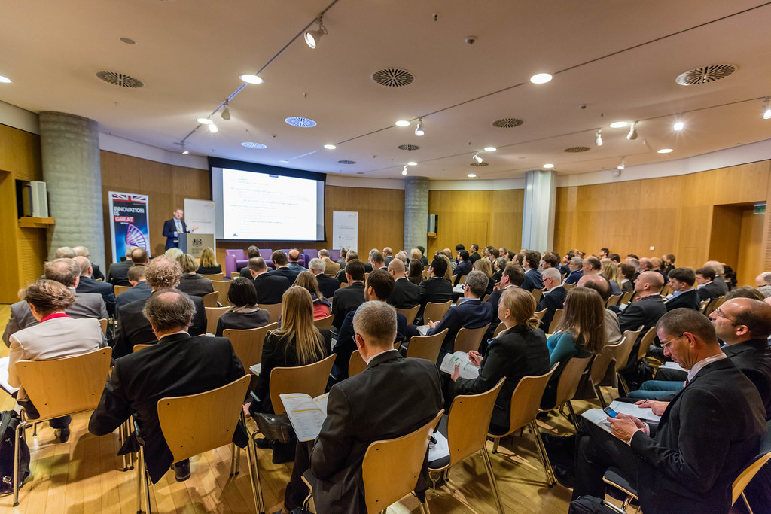
Science Communication has Changed
Old Way
  Obtain funding
  Do the research
  Publish the research
    Limited audience
    Paywalls
  (Present at a conference)
  Repeat

Slide 7
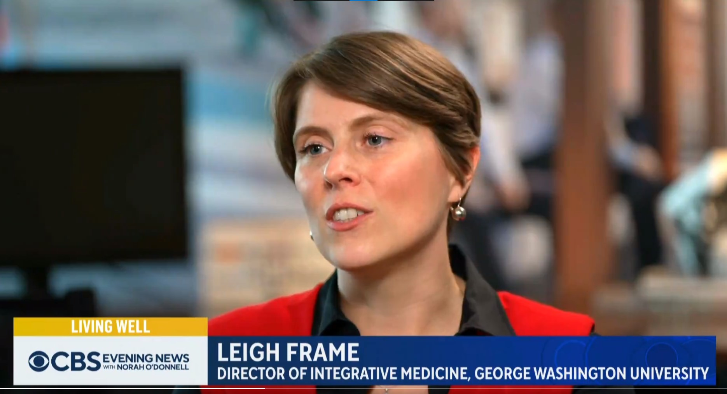
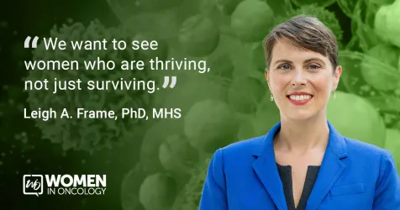
Science Communication has Changed
New Way
  Obtain funding
  Do the research
  Disseminate the research
    Submit for peer review
    Prepare a press release
    Press release on publication day
    Social media blast
    Media tour
    Speaking engagements (e.g. conferences)
  Change the field, educate the public
  Repeat

Slide 8
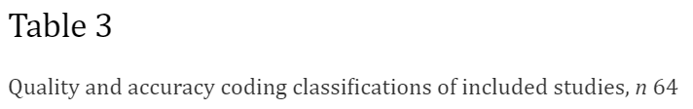
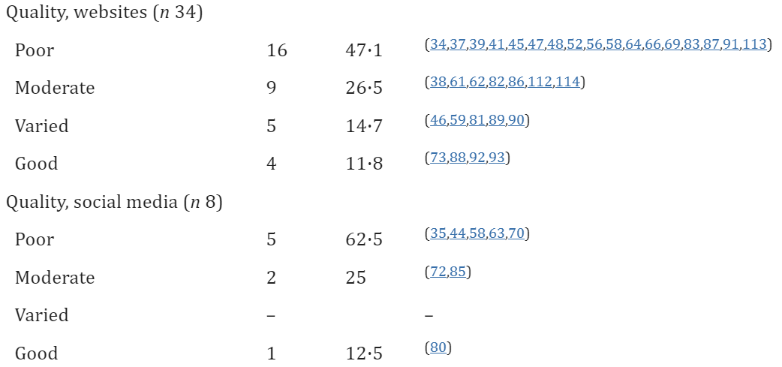
Nutrition Champions are Needed!
Misinformation
Disinformation
30/34 (88.2%)
7/8 (87.5%)
Denniss E, Lindberg R, McNaughton SA. Public Health Nutr. 2023. doi: 10.1017/S1368980023000873.

Slide 9

Social media platforms 101

Slide 10
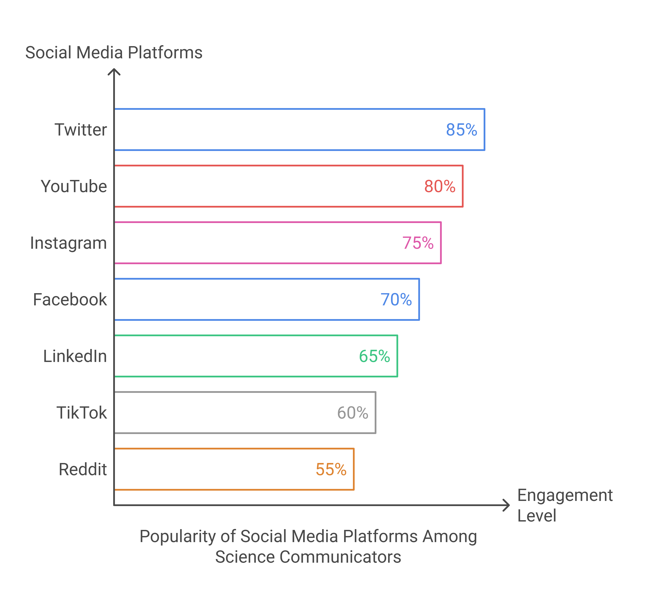
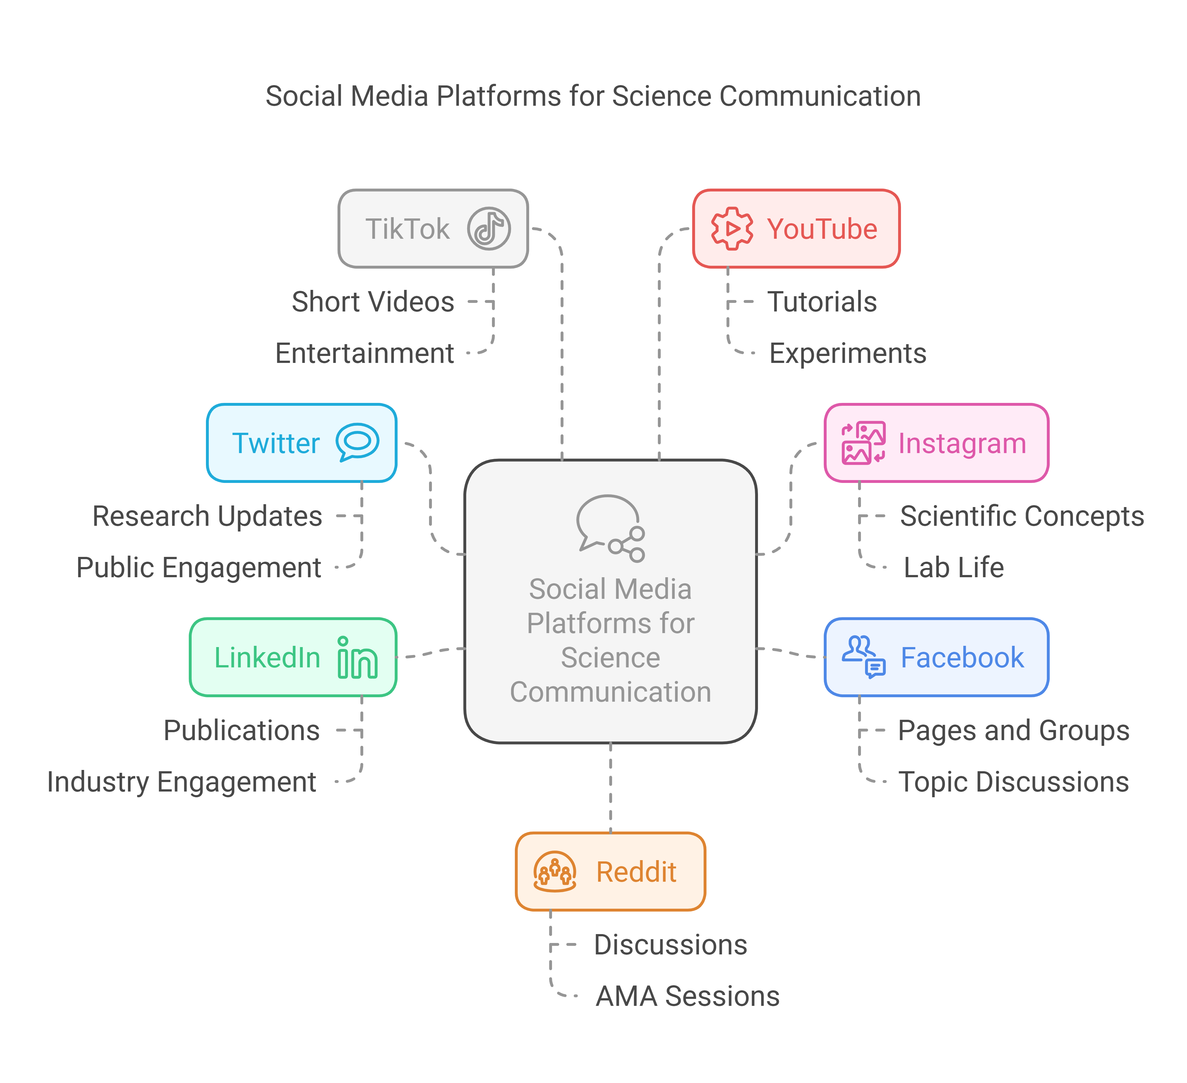
Social Media Platforms 101
(2022)

Slide 11

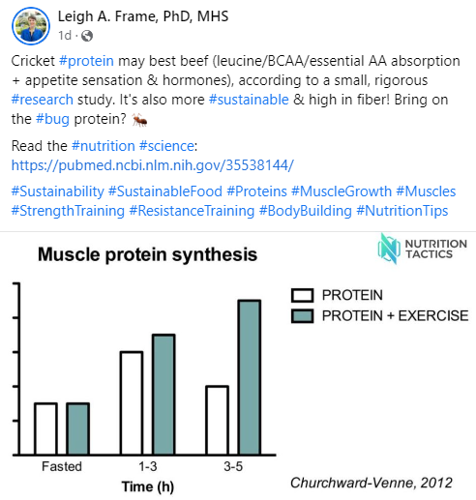
Social Media Platforms 101: Facebook
Pages for professional accounts
Post directly to FB and Insta(gram) through one interface
Very versatile
  Local marketing/targeting
  Fast growing in the 65+ age category
Mostly photos and links
Video drives impressions

Slide 12

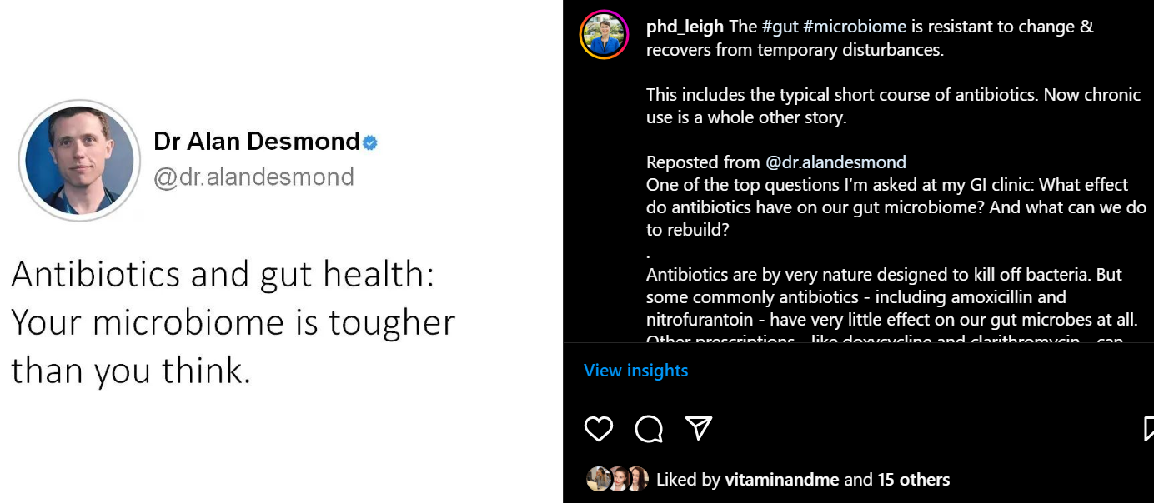
Social Media Platforms 101: Instagram
Unique photo dimensions
Post to FB from Insta (Twitter, sort of)
Good for organic engagement
  Building your audience
  Hence the Influencer craze
Reposted on Insta with a repost app
Trending:
Reposting
Tweets

Slide 13

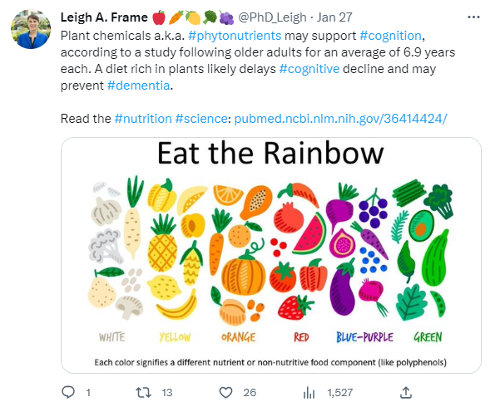
Social Media Platforms 101: Twitter/X
Versatile with a large STEM+ and higher-ed community
Great source for news and the latest research/science debates
My favorite platform!

Slide 14
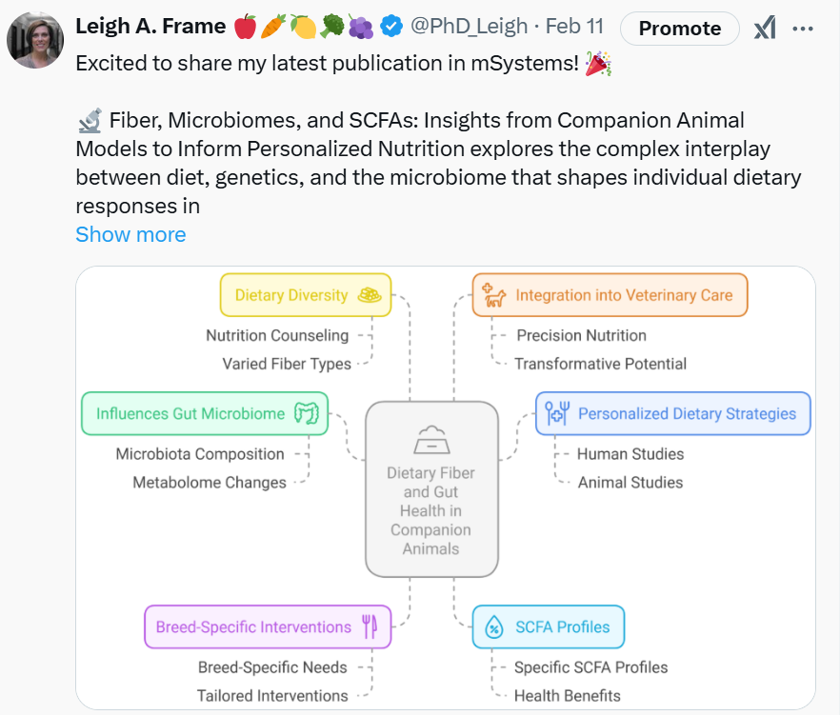
Social Media Platforms 101: Twitter
360 characters per Tweet
Premium(+)
  25,000 characters
  Longer videos
  Create a Community
  Creator Subscriptions
  Reply to verified-only posts
  Fewer Ads
  Ads revenue share
  Etc.

Slide 15
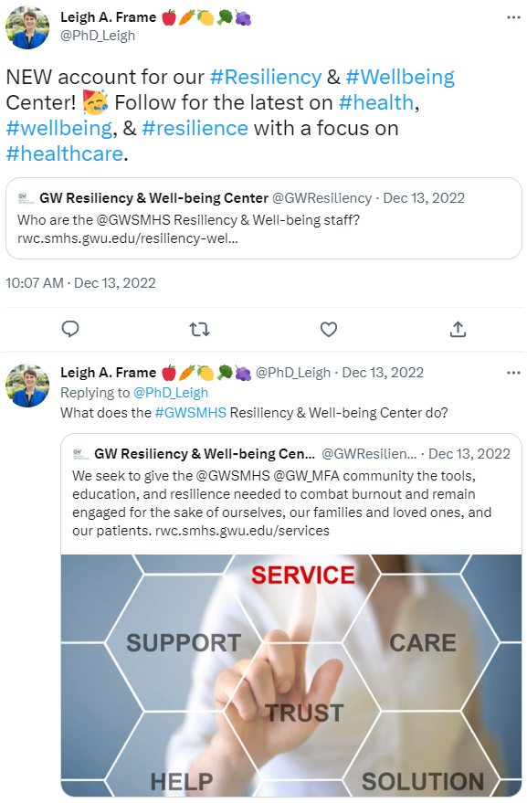
Social Media Platforms 101: Twitter
360 characters per Tweet (unpaid)
Making Threads popular
  Some number when pre-planned
  (1/n, 2/n…n/n)
  Can be shared as a single webpage by “unrolling” it with an app such as Thread Reader

Slide 16

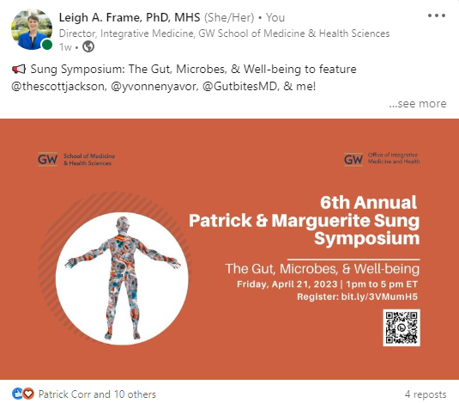
Social Media Platforms 101: LinkedIn
Professional networking + content creation
Tap into your network + organic engagement
Highest engagement with 1500-1900 words, but most are short
Think professional and personal development
Forgot to update for LinkedIn!

Slide 17

Why are you here?
A Vision, Mission, and Values Mini-Workshop

Slide 18
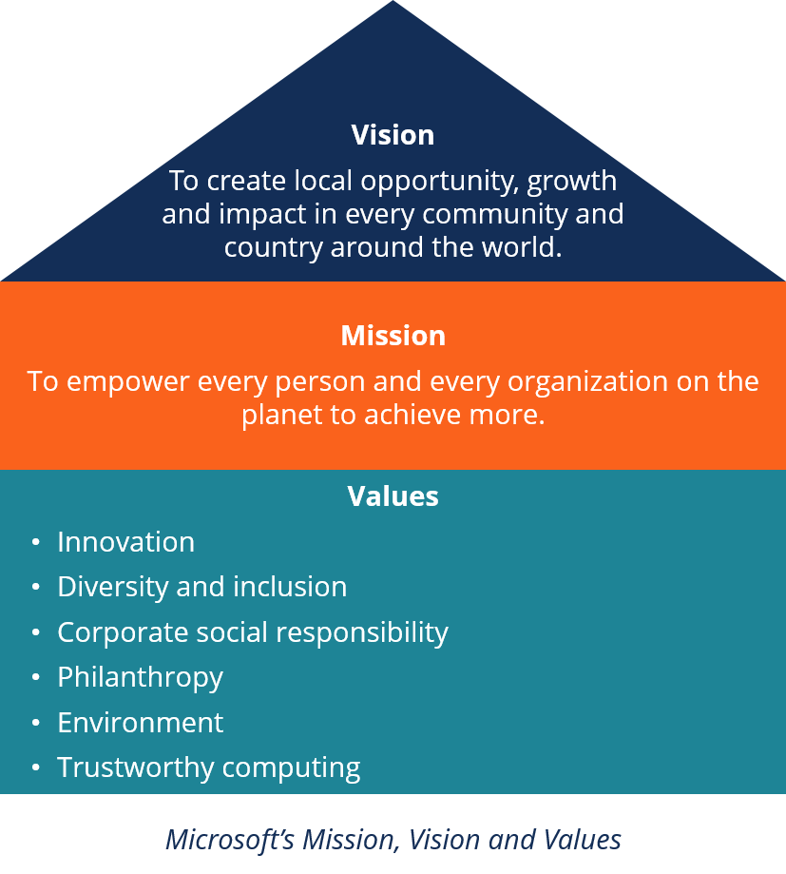
Why are You Here?
Identify your mission
  Why do you want to do this?
    Promotion and tenure?
    Counter misinformation?
    Research dissemination?
    Don’t know?

Slide 19
Why are You Here?
Vision
Everyone has the
knowledge/ability/access to
what they need to live their best lives.
Identify your mission
  Write 1-2 sentences that will guide you
    Help you decide what opportunities to take
    Determine appropriate content
    Determine your audience
Mission
To make the world a happier, healthier place.
Critical Thinking
Empowerment
Compassion
Growth-mindset
Leigh Frame’s Mission, Vision, and Values

Slide 20

Where to start?
A Science Communicators Guide to Social Media

Slide 21
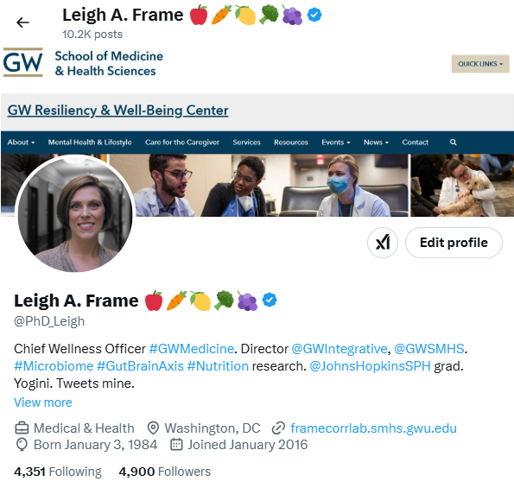
Building a Social Media (SoMe) Presence
Open an account (or 2, maybe 3)
Develop your brand based on your Mission, Vision, & Values

Slide 22
Building a Social Media (SoMe) Presence
Design your page to attract your audience
  Who is your audience?
  Brainstorm & write this down

Slide 23
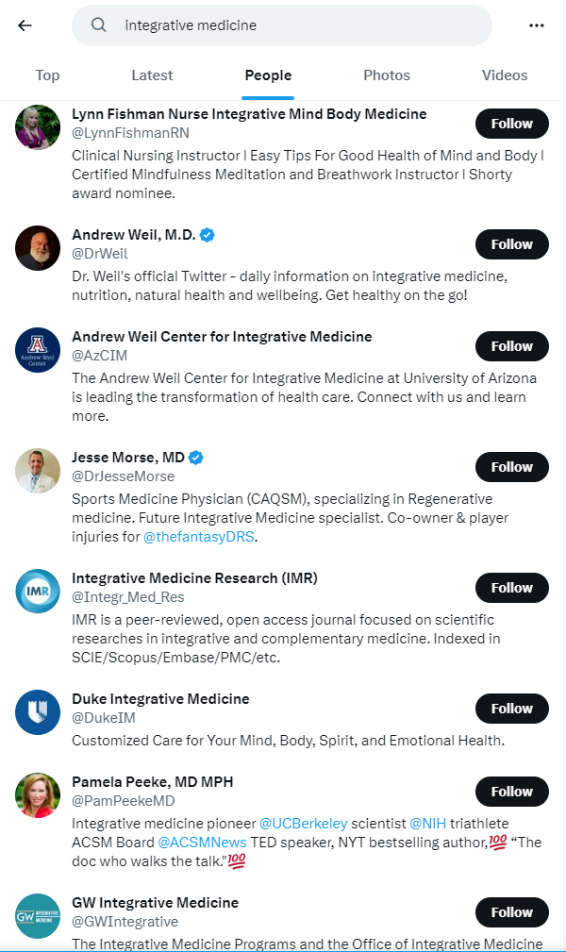
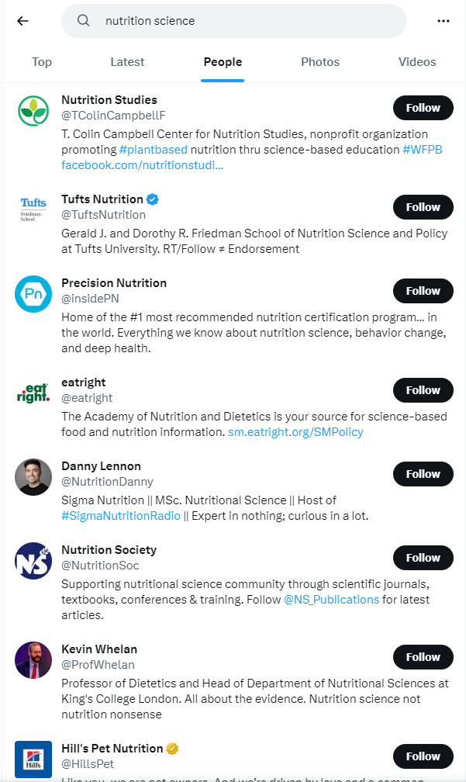
Building a SoMe Presence
Start following accounts you’d like to be like
  May follow back
  Will give you ideas
  You can share their content with your thoughts

Slide 24
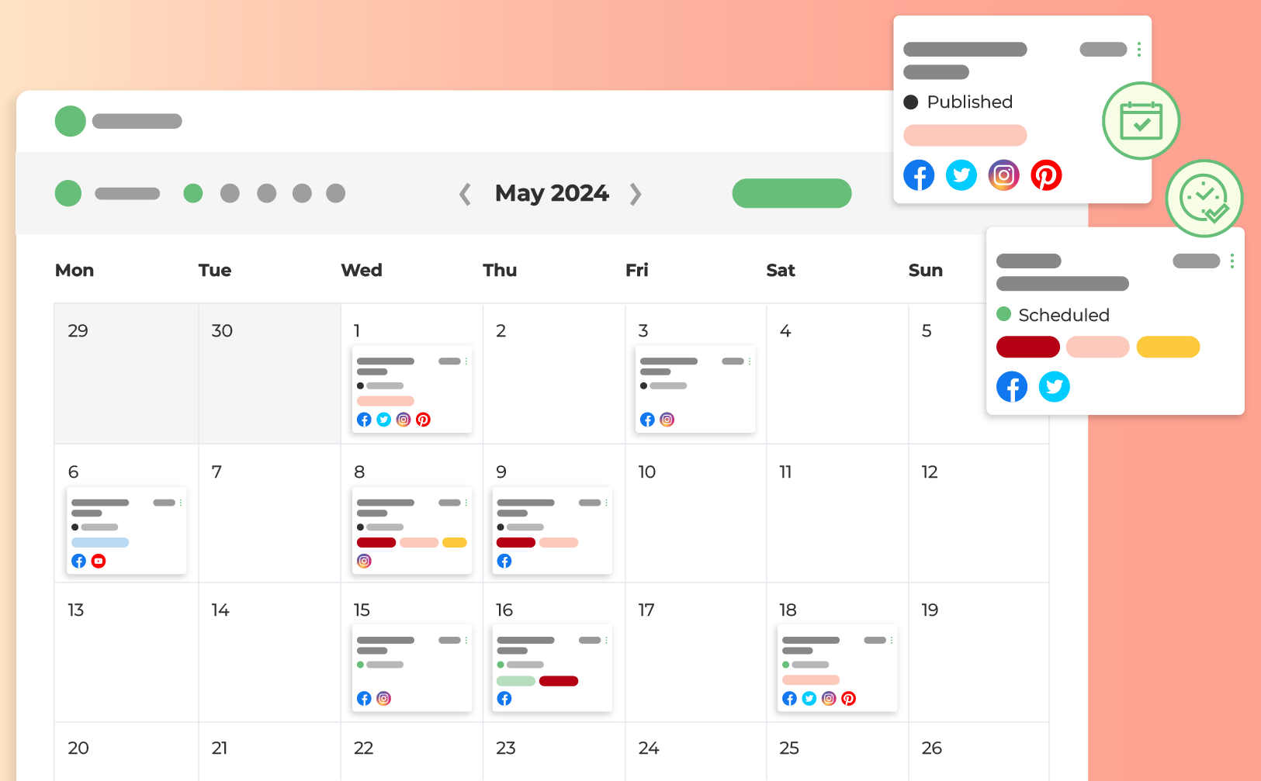
Maintaining Your Social Media Presence
Post on a regular schedule
Best Free Social Media Scheduler (Zapier)
https://www.loomly.com/blog/social-media-calendar-examples

Slide 25
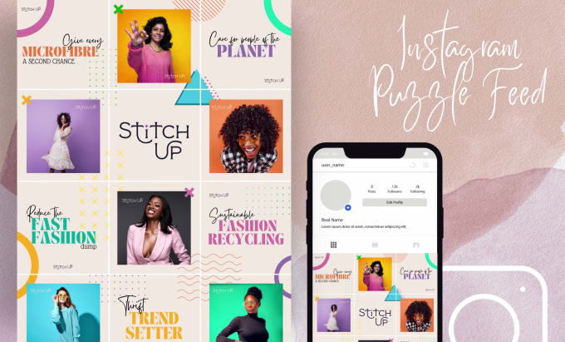
Maintaining Your Social Media Presence
Don’t post all at once…unless you’re doing this on Instagram

Slide 26
Maintaining Your Social Media Presence
Don’t post all at once…unless you’re doing this on Instagram
This is an advanced maneuver!
But you can hire people to design this for you.
https://www.fiverr.com/tayyabrafiq000/design-minimal-instagram-grid-and-puzzle-feed

Slide 27

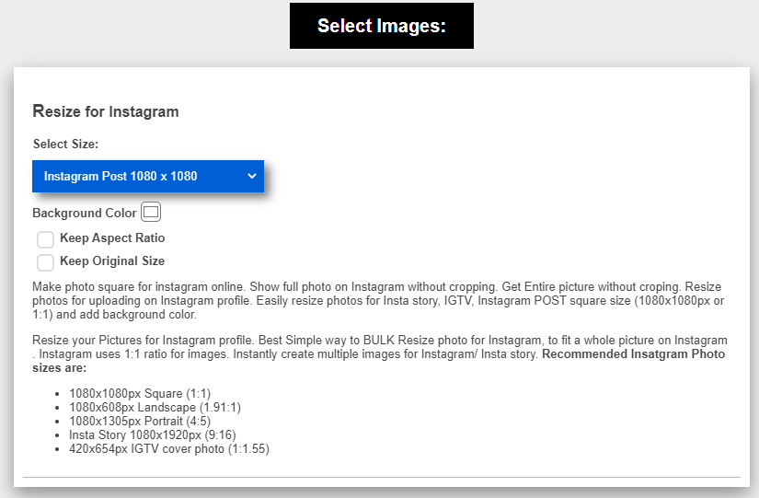

Fit for Purpose Content
Landscape: Facebook, Twitter, LinkedIn
Square: Instagram
Hack for getting it right
  Pixoate Online Photo Editor
  Instagram Photo resize

Slide 28
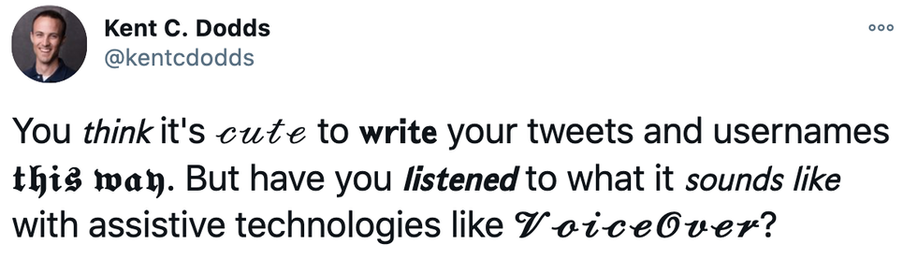
Be Inclusive: In Your Text
Clear messages with minimal jargon/slang
Case sensitive
  Skip/limit all caps
  #MakeItAccessible: Capitalize the 1st letter of each word in a hashtag
Be descriptive: “Sign up” or “Read more” instead of “Click here”
Screen readers read everything aloud
  # and @ aloud
  (put most at the end)
  Limit emojis and
  special characters
  Avoid special text
https://blog.hootsuite.com/inclusive-design-social-media/

Slide 29
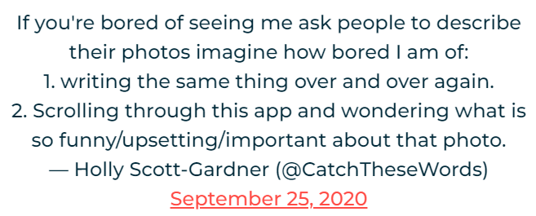
Be Inclusive: With Images & Videos
Describe images and videos in your text or the alt text
  Purely decorative photos are typically skipped (or check box)
  Describes photos to visualize images
    Content
    Color (if relevant)
    Text (if present)
Videos need captions
  Many now autogenerate these
  May need proofreading
https://blog.hootsuite.com/inclusive-design-social-media/

Slide 30

Be Inclusive: With Imaging
Avoid only using photos of people who look like you (or not like you)
Diverse photos will help appeal to a diverse audience

Slide 31
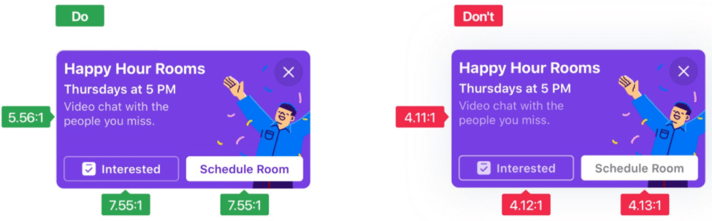
Be Inclusive: With Color
High contrast (~4.5:1)
Avoid green/red and blue/yellow combos
Don’t rely only on color to denote meaning
https://blog.hootsuite.com/inclusive-design-social-media/

Slide 32
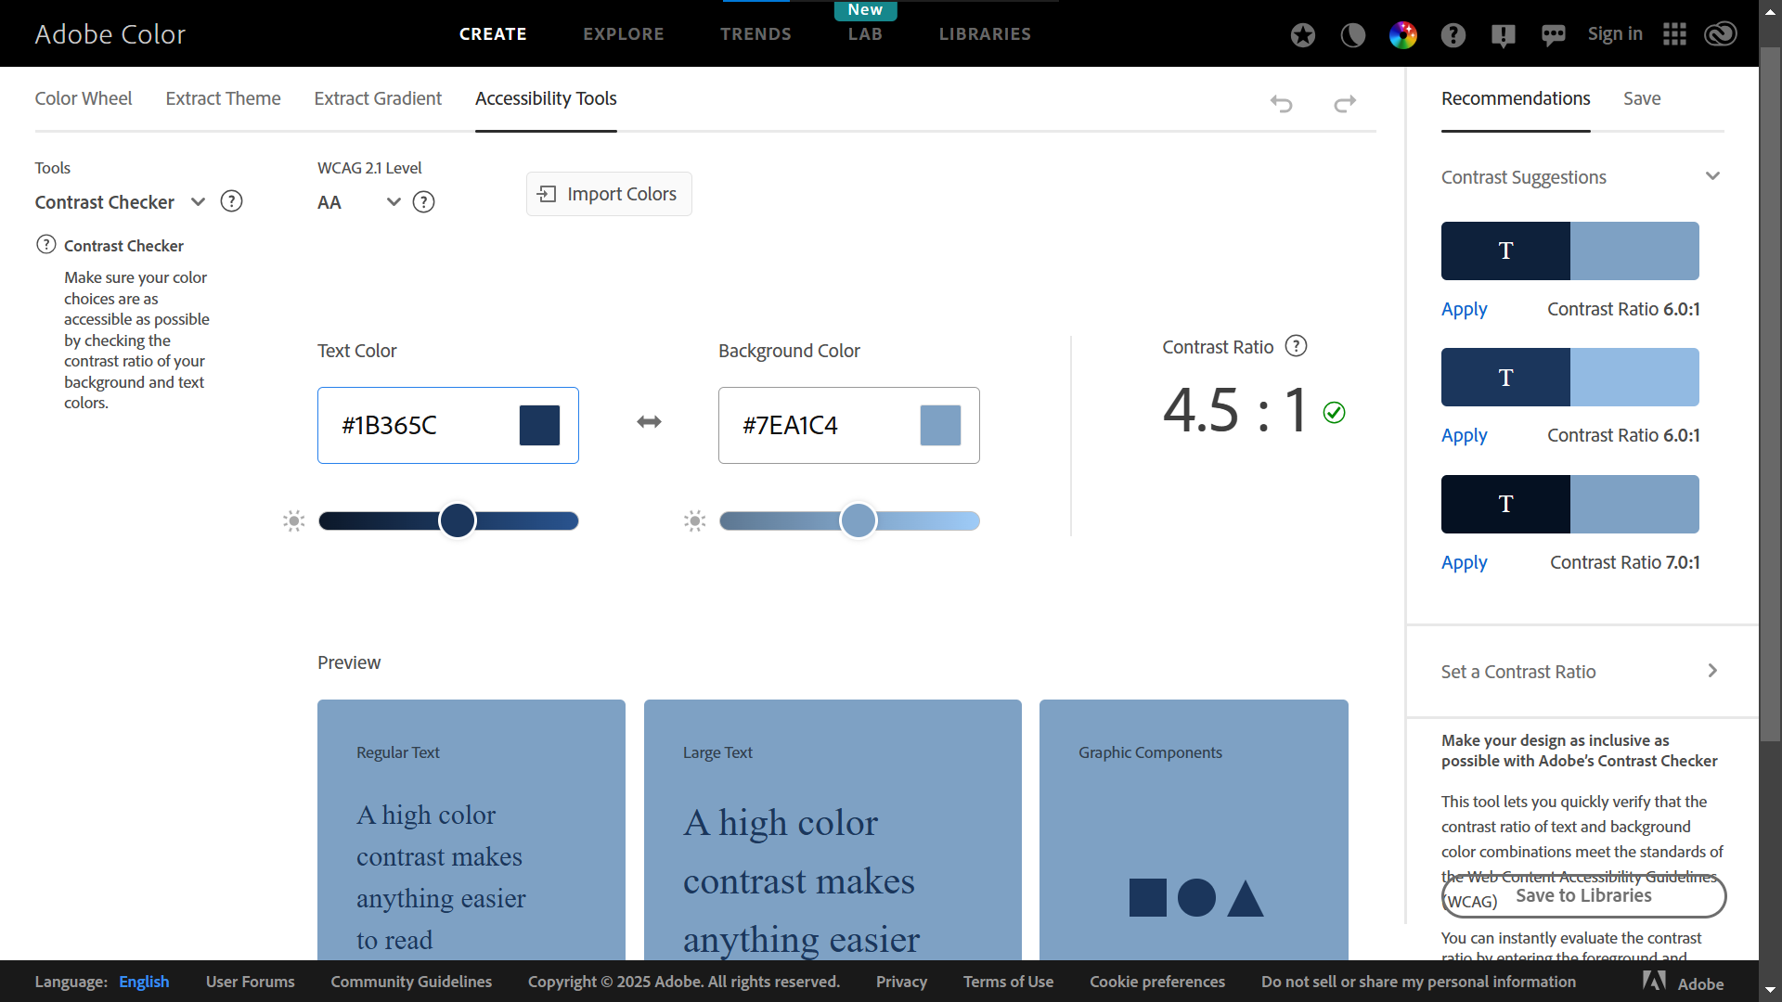
Be Inclusive: With Color
Adobe Color Contrast Analyzer
https://color.adobe.com/create/color-contrast-analyzer

Slide 33
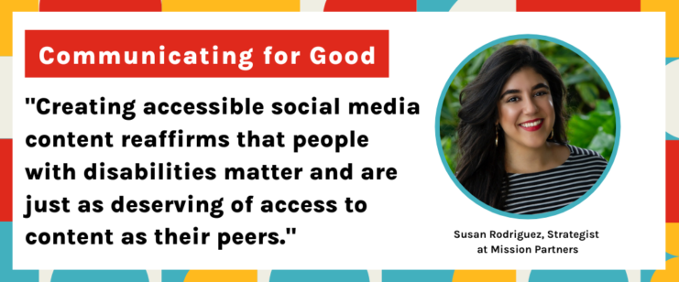
Be Inclusive on Social Media
https://mission.partners/wp-content/uploads/2022/08/MicrosoftTeams-image-16-1030x343.png

Slide 34
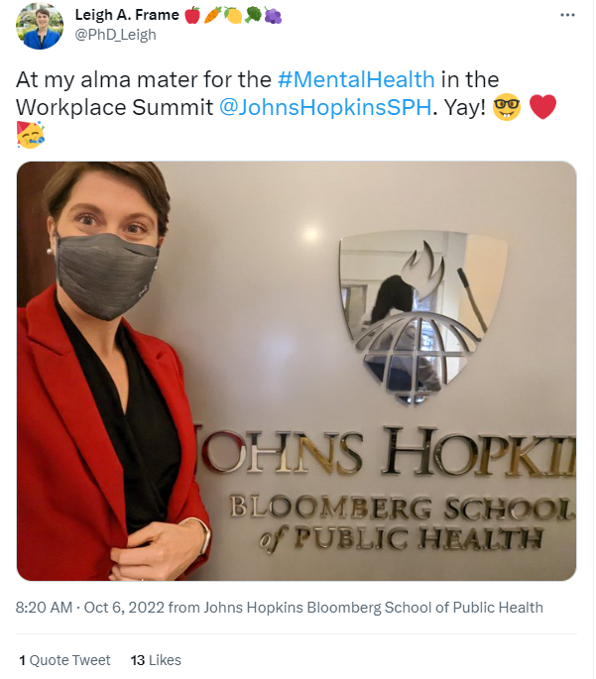
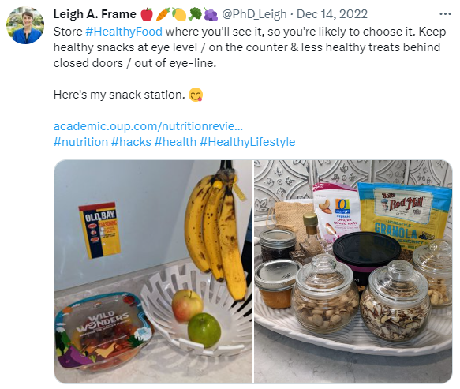
Share Authentically
Let them know who you are

Slide 35
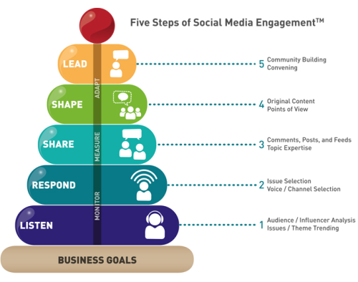
Don’t Just Schedule & Check Out
Engage with comments
  Don’t succumb to trolls
  Not every comment needs a response
  Some may need to be deleted/blocked
Be an active member of your community
Five Steps of Social Media Engagement

Slide 36

Where to Start?
Pick one platform that you would like to start with.
Group & share
  Facebook
  Instagram
  Twitter
  LinkedIn
Why academics should make time for social media | Times Higher Education (THE)

Slide 37

Where to Start?
What concerns do you have about getting starting?

Slide 38

Just Do It
Pick your handle
  Carefully
    It will stick with you
    You can update your handle (at least in Twitter) without creating a new account, but lose connection with old tags
  The same across all platforms (ideally)

Slide 39
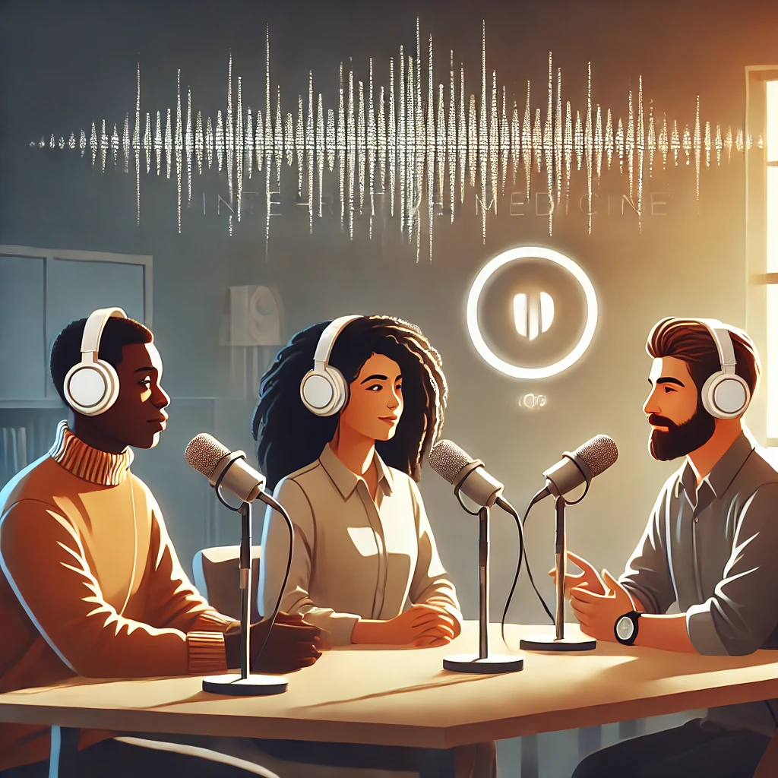
Lessons Learned
GW Integrative Medicine Podcast

Slide 40

Download
Listen
Learn
Live
@PhD_Leigh #GWSMHS

